Slide 1


CS375 –MODERN NETWORKS
DECEMBER 2020– JULY 2021
Chapter – 1
Elements of Modern Networking

Slide 2
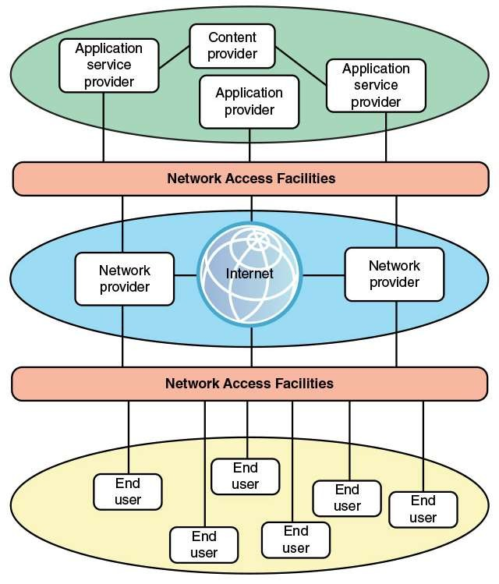


1.1 The Networking Ecosystem
Figure depicts the modern networking ecosystem in very general terms.
The entire ecosystem exists to provide services to end users.
The term end user, or simply user, is used here as a very general term, to encompass users working within an enterprise or in a public setting or at home.
The user platform can be fixed (for example, PC or workstation), portable (for example, laptop), or mobile (for example, tablet or
smartphone).

Slide 3
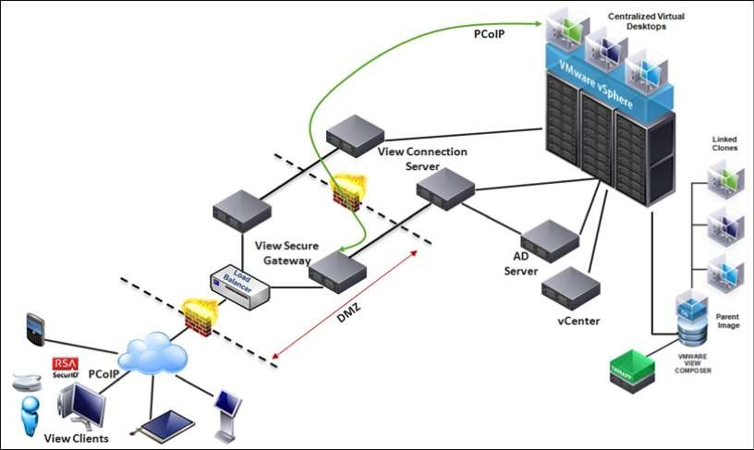
1.1 The Networking Ecosystem end user
The ultimate consumer of applications, data and services on a computing platform.

Slide 4
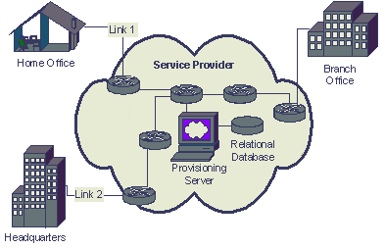
1.1 The Networking Ecosystem
network provider
An organization
communications
that
delivers
services over a
typically large geographic area.
It provides, maintains, and manages network equipment and networks, either public or private.
Users connect to network-based services and content through a wide variety of network access facilities.
These include digital subscriber line (DSL) and cable modems, Wi-Fi and Worldwide Interoperability for Microwave Access (WiMAX) wireless modems, and cellular modems.
Application providers provide applications, or apps, that run on the user’s platform, which is typically a mobile platform.

Slide 5
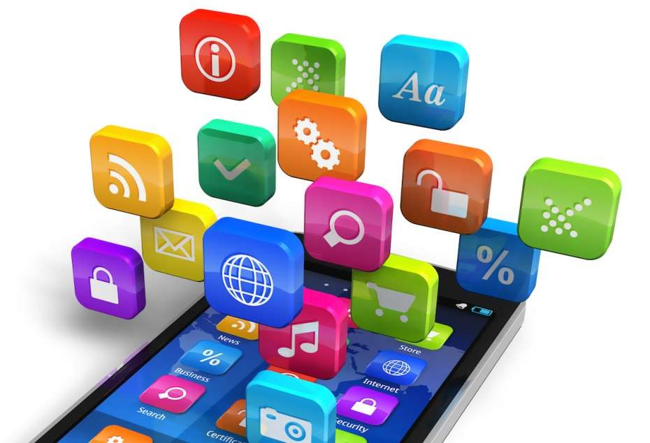
1.1 The Networking Ecosystem
application provider
An entity generating/selling user applications to be executed on the user’s platform.
A distinct زراب category of provider is the application service provider.
Whereas the application provider downloads software to the user’s platform, the application service provider acts as a server or host of application software that is executed on the provider’s platforms.
Traditional examples of such software include web servers, e-mail servers, and database servers.
The most ريهش prominent example now is the cloud computing provider.

Slide 6
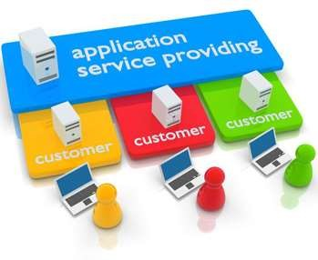
1.1 The Networking Ecosystem application service provider
An organization that hosts
software
applications within its own facilities.
It provides network-accessible applications such as e-mail, web hosting, banking, and cloud-based services.
A content provider serves the data to be consumed on the user device (for example, e-mail, music, video).
This data may be commercially provided intellectual property.
In some instances, an enterprise may be an application or content provider.
Examples of content providers are music record labels and movie studios.

Slide 7
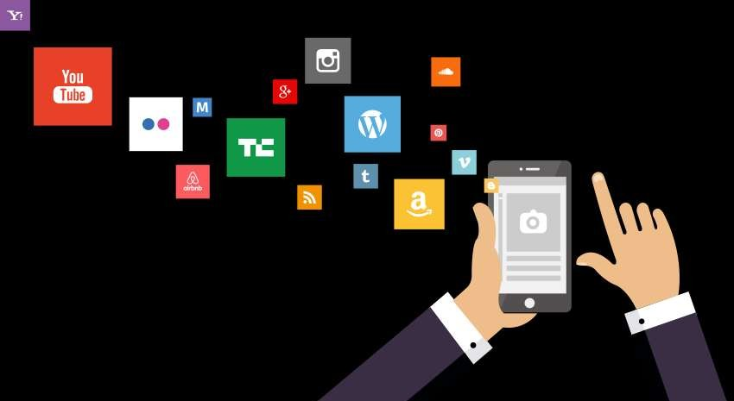
1.1 The Networking Ecosystem content provider
An organization or individual that creates information, including educational or entertainment content,
distributed via the Internet or enterprise networks.
A content provider may or may not provide the software used to access the material.

Slide 8
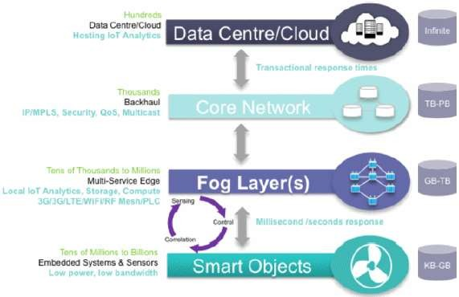
1.1 The Networking Ecosystem
It is worth pointing out here two major elements of modern networking not explicitly depicted in this figure:
Data center networking:
Both large enterprise data centers and cloud provider data centers consist of very large numbers of interconnected servers.
Typically, as much as 80 percent of the data traffic is within the data center network, and only 20 percent relies on external networks to reach users.
IoT or fog networking:
An Internet of Things deployed by an enterprise may consist of hundreds, thousands, even millions of devices.

Slide 9
1.2 EXAMPLE NETWORK ARCHITECTURES
This section introduces two example network architectures, and with them some of the networking terminology in common use.
A Global Network Architecture
A Typical Network Hierarchy

Slide 10
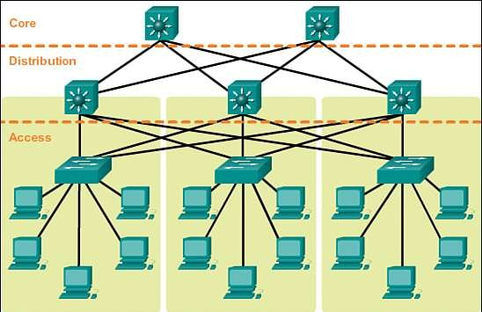
1.2 EXAMPLE NETWORK ARCHITECTURES A Typical Network Hierarchy
This section focuses in on a network architecture that, with some variation, is common in many enterprises.
enterprises often design their network facilities in a three-tier hierarchy: access, distribution, and core.
access network is A network that connects
directly to the end user
Typically, an access network is a local- area network (LAN) or campus-wide network that consisting of LAN switches (typically Ethernet switches) and, in larger LANs, IP routers that provide connectivity among the switches.
Layer 3 switches are also commonly used within an LAN.
The access network supports end user equipment, such as desktop and laptops.

Slide 11
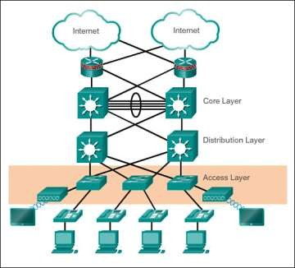
Foundations of Modern Networking PART I Modern Network
Chapter 1: Elements of Modern Networking
1.2 EXAMPLE NETWORK ARCHITECTURES A Typical Network Hierarchy
access network
A network that connects directly to the end user
Typically, an access network is a local- area network (LAN) or campus-wide network that consisting of LAN switches (typically Ethernet switches) and, in larger LANs, IP routers that provide connectivity among the switches.
Layer 3 switches are also commonly used within an LAN.
The access network supports end user equipment, such as desktop and laptop computers and mobile devices.
The access network also supports local servers that primarily or exclusively serve the users on the local access network.

Slide 12
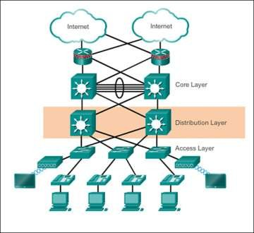
1.2 EXAMPLE NETWORK ARCHITECTURES A Typical Network Hierarchy distribution network
connects access networks with each other and with the core network.
An edge router in the distribution network connects to an edge router in an access network to provide connectivity.
The two routers are configured to recognize each other and will generally exchange routing and connectivity information and, typically, some traffic-related information.
This cooperation between routers is referred to as peering.
The distribution network also serves to aggregate traffic destined for the core router, which protects the core from high-density peering.
That is, the use of a distribution network limits the number of routers that establish peer relationships with edge routers in the core, saving memory, processing, and transmission

Slide 13
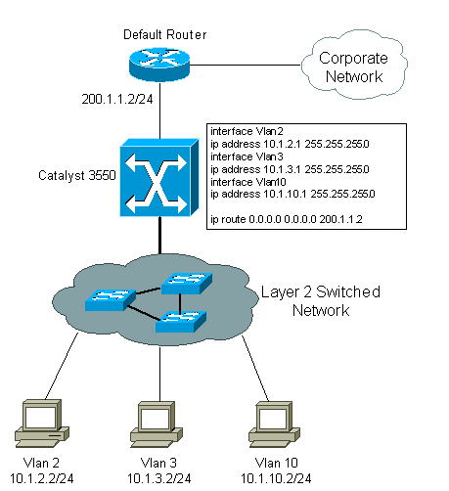
1.2 EXAMPLE NETWORK ARCHITECTURES A Typical Network Hierarchy
Layer 3 (L3) switch
A high-performance device for network routing.
Layer 3 switches are very similar to routers.
The key difference between L3 switches and routers is that a L3 switch replaces some of a router’s software logic with hardware to offer better performance.
L3 switches often cost less than traditional routers. Designed for use within LANs, a L3 switch will typically not possess the WAN ports and WAN features a traditional router has.
One or more access routers connect the local assets to the next higher level of the hierarchy, the distribution network.
This connection may be via the Internet or some other public or private communications facility.
Thus, as described in the preceding subsection, these access routers function as edge routers that forward traffic into and out of the access network.

Slide 14
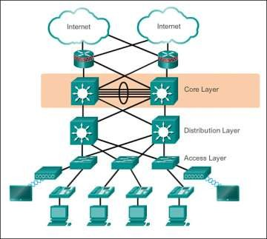
1.2 EXAMPLE NETWORK ARCHITECTURES A Typical Network Hierarchy core/backbone network
A central network that provides networking services to attached distribution and access networks.
Also referred to as a backbone network.
A hierarchical network architecture is an example of a good modular design.
With this design, the capacity, features, and functionality of network equipment (routers, switches, network management servers) can be optimized for their position in the hierarchy and the requirements at a given hierarchical level.
peering
An agreement between two routers to accept each other’s data packets and forward them.
A peer relationship generally involves the exchange of routing information.

Slide 15
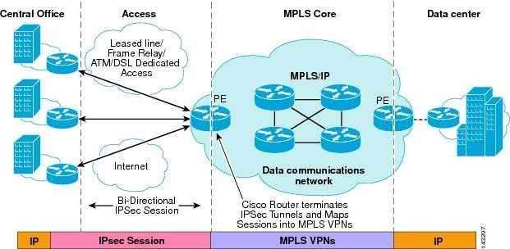
1.2 EXAMPLE NETWORK ARCHITECTURES
.A Global Network Architecture
an architecture that could represent an enterprise network of national or global extent, or a portion of the
Internet with some of its associated networks.

Slide 16
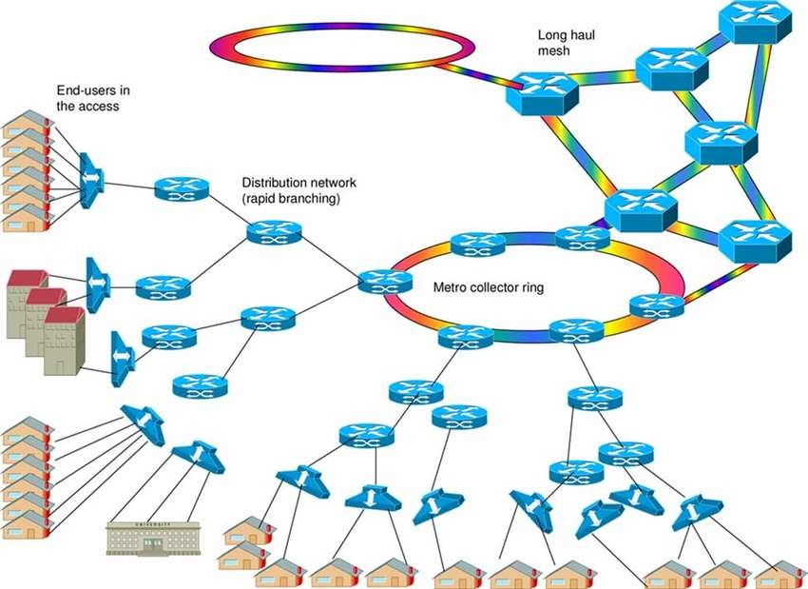
1.2 EXAMPLE NETWORK ARCHITECTURES
.A Global Network Architecture
router
A network device that forwards data packets from one network to another.
The forwarding decision is based on network layer information and routing tables, often constructed by outing protocols.
Routers require packets formatted in a routable protocol, the global standard being the Internet Protocol (IP).
At the center of the figure is an IP backbone, or core, network, which could represent a portion of the Internet or an enterprise IP network.
Typically, the backbone consists of high- performance routers, called core routers, interconnected with high-volume optical links.
The optical links often make use of what is known as wavelength-division multiplexing (WDM), such that each link has
multiple logical channels occupying different portions of the optical bandwidth.

Slide 17
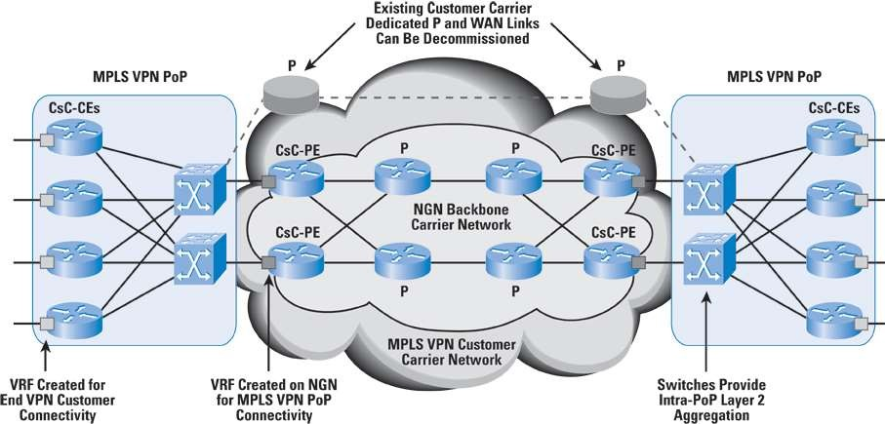
1.2 EXAMPLE NETWORK ARCHITECTURES
.A Global Network Architecture
core router
A router that resides within the middle of the network rather than at its periphery.
The routers that make up the backbone of the Internet are core routers.
At the periphery of an IP backbone are routers that provide connectivity to external networks and users.
These routers are sometimes referred to as edge routers or aggregation routers.

Slide 18
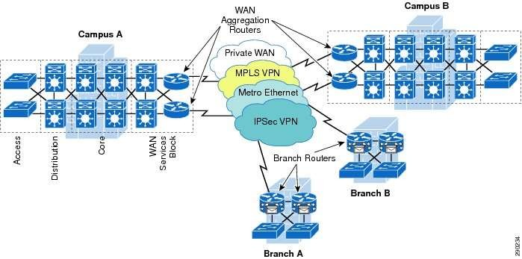
1.2 EXAMPLE NETWORK ARCHITECTURES
.A Global Network Architecture
Aggregation routers
used within an enterprise network to connect a number of routers and switches, to external resources, such as an IP backbone or a high-speed WAN.
As an indication of the capacity requirements for core and aggregation routers, the IEEE Ethernet Bandwidth Assessments Group [XI11] reports on an analysis that projects these requirements for Internet backbone providers and large enterprise networks in China.
The analysis concludes that aggregation router requirements will be in the range of 200 Gbps to 400 Gbps per optical link.

Slide 19
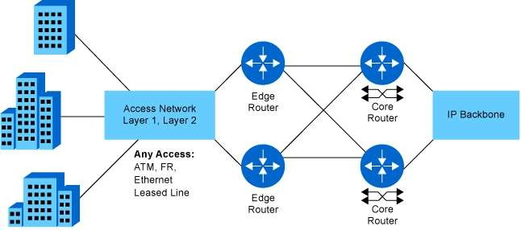
1.2 EXAMPLE NETWORK ARCHITECTURES
.A Global Network Architecture
edge router
A router that sits at the periphery of a network.
two sections of the network connected via a private high-speed WAN, with switches interconnected with optical links.
MPLS using IP is a common switching protocol used for such WANs; wide-area Ethernet is another option.
Enterprise assets are connected to, and protected from, an IP backbone or the Internet via routers with firewall capability, a not uncommon arrangement for implementing the firewall.
Connection to the Internet through a router could be through a cable or DSL connection or a dedicated high-speed link.
Common examples of such a connection are a DSL, which provides a high-speed link over telephone lines and requires a special DSL modem, and a cable TV facility, which requires a cable modem, or some type of wireless connection.

Slide 20
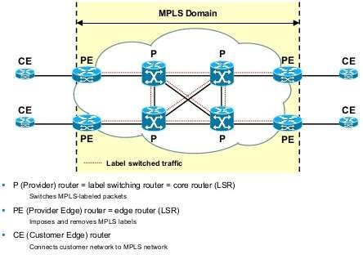
1.2 EXAMPLE NETWORK ARCHITECTURES
.A Global Network Architecture Multiprotocol Label Switching (MPLS)
A protocol developed by IETF for directing packets in a wide- area IP network, or other WAN.
MPLS adds a 32-bit label to each packet to improve network efficiency and to enable routers to direct packets along predefined routes in accordance with the required quality of service.

Slide 21
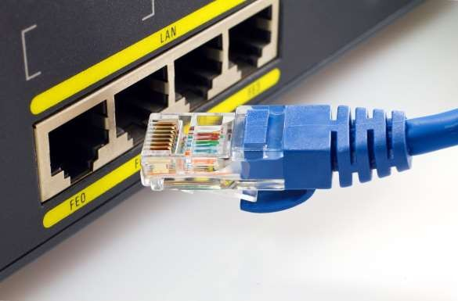
1.3 ETHERNET
Ethernet is The commercial name for a wired local-area network technology.
It involves the use of a shared physical medium, a medium access control protocol, and transmission of data in packets.
Standards for Ethernet products are
defined by the IEEE 802.3 committee.
This section begins with discussion of Ethernet applications, and then looks at standards and performance.

Slide 22
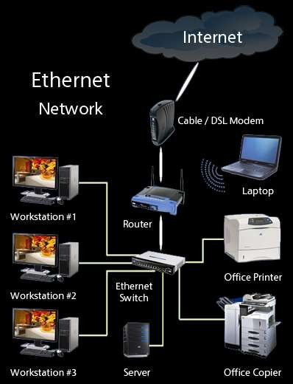
1.3 ETHERNET Applications of Ethernet
Ethernet is the predominant wired networking technology, used in homes, offices, data centers, enterprises, and WANs.
As Ethernet has evolved to support data rates up to 100 Gbps and distances from a few meters to tens of kilometers, it has become essential for supporting personal computers, workstations, servers, and massive data storage devices in organizations large and small.

Slide 23
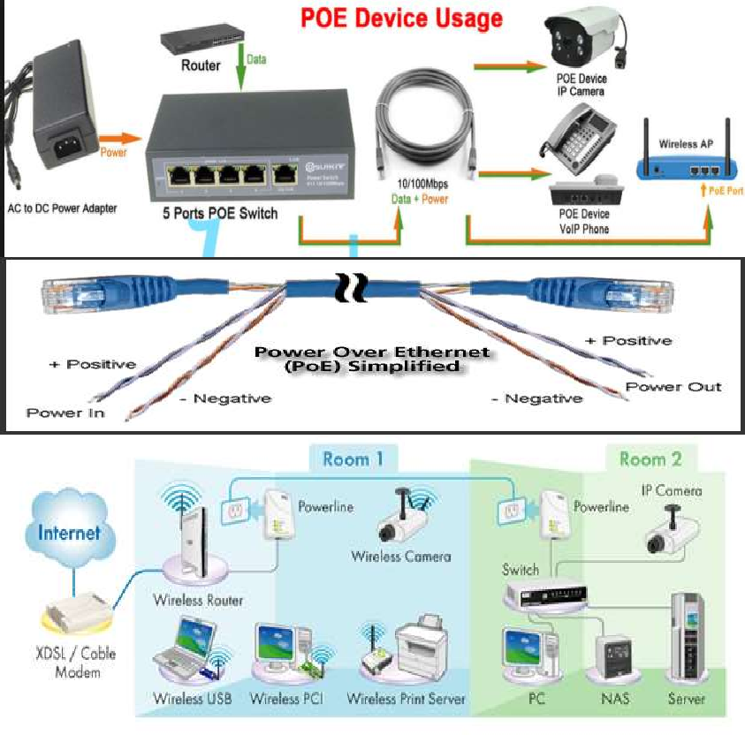
1.3 ETHERNET Ethernet in the Home
Ethernet has long been used in the home to create a local network of computers with access to the Internet via
a broadband modem/router.
With the increasing availability of high-speed, low-cost Wi-Fi on computers, tablets, smartphones, modem/routers, and other devices, home reliance on Ethernet has declined.
Two recent extensions of Ethernet technology have enhanced and broadened the use of Ethernet in the home: powerline carrier (PLC) and Power over Ethernet (PoE).
Powerline modems take advantage of existing power lines and use the power wire as a communication channel to transmit Ethernet packets on top of the power signal.
This makes it easy to include Ethernet-capable devices throughout the home into the Ethernet network.

Slide 24
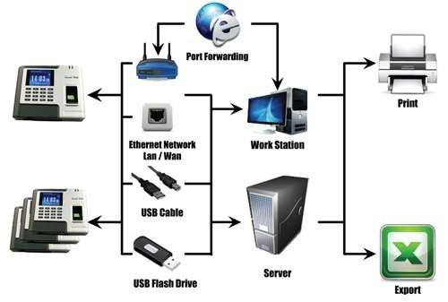
1.3 ETHERNET Ethernet in the Office
.Early on there were some competitors, such as IBM’s Token Ring LAN and the Fiber Distributed Data Interface (FDDI), but the simplicity, performance, and wide availability of Ethernet hardware eventually made Ethernet the winner.
Much of the traffic in a typical office environment now travels on Wi-Fi, particularly to support mobile devices
Therefore, a combination of Ethernet and Wi-Fi is the most common architecture.
The LAN connects to the Internet/WANs via a firewall.
A hierarchical arrangement of routers and switches provides the interconnection of servers, fixed user devices, and wireless devices.
Typically, wireless devices are only attached at the edge or bottom of the hierarchical architecture; the rest of the campus infrastructure is all Ethernet.

Slide 25
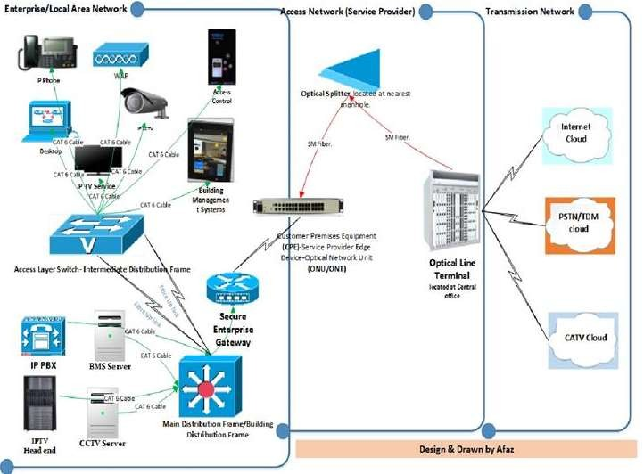
1.3 ETHERNET
Ethernet in the Enterprise
A tremendous advantage of Ethernet is that it is possible to scale the network, both in terms of distance and data rate, with the same Ethernet protocol and associated quality of service (QoS) and security standards.
An enterprise can easily extend an Ethernet network among a number of buildings on the same campus or even some distance apart, with links ranging from 10 Mbps to
100 Gbps, using a mixture of cable types and Ethernet hardware.
Because all the hardware and communications software conform to the same standard, it is easy to mix different speeds and different vendor equipment.
The same protocol is used for intensive high-speed interconnections of data servers in a single room, workstations and servers distributed throughout the building,

Slide 26
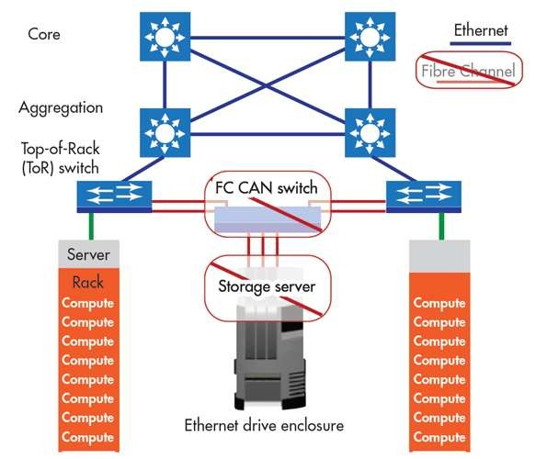
1.3 ETHERNET
Ethernet in the Data Center
Ethernet has come to dominate in the data center, where very high data rates are needed to handle massive volumes of data among networked servers and storage units.
Historically, data centers have employed various technologies to support high- volume, short-distance needs, including InfiniBand and Fiber Channel.
But now that Ethernet can scale up to
100 Gbps, with 400 Gbps on the horizon, the case for a unified protocol approach throughout the enterprise is compelling.
Two features of the new Ethernet approach are noteworthy.
For co-located servers and storage units, high-speed Ethernet fiber links and switches provided the needed networking infrastructure.

Slide 27
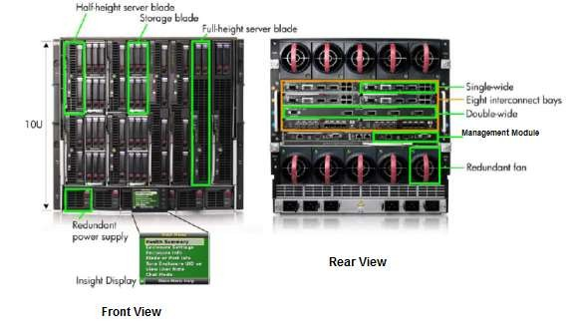
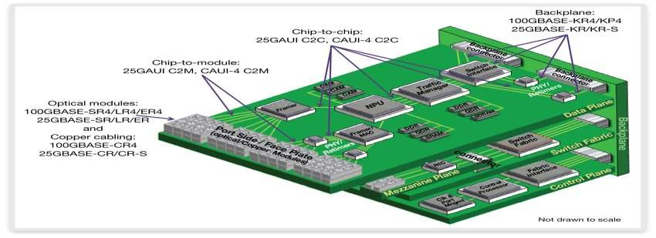
1.3 ETHERNET
Ethernet in the Data Center
Another important version of Ethernet is
known as backplane Ethernet.
Backplane Ethernet runs over copper jumper cables that can provide up to 100 Gbps over very short distances.
This technology is ideal for blade servers, in which multiple server modules are housed in a single chassis.
blade server
A server architecture that houses multiple server modules (blades) in a single chassis.
It is widely used in data centers to save space and improve system management.
Either self-standing or rack mounted, the chassis
provides the power supply, and each blade has its own CPU, memory, and hard disk.

Slide 28
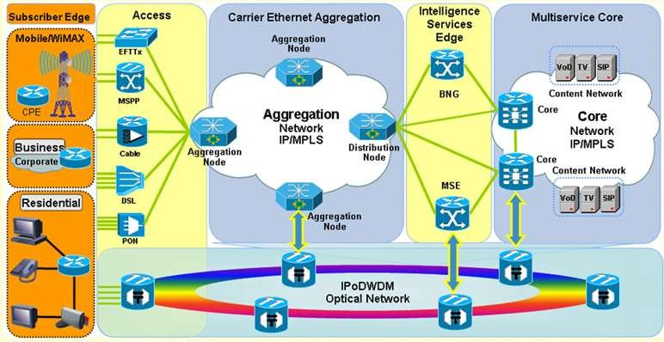
1.3 ETHERNET
Ethernet for Wide-Area Networking
More telecommunications and network providers have switched to Ethernet from alternative schemes to support wide-area access (also referred to as first mile or last mile).
Ethernet is supplanting a variety of other wide area options, such as dedicated T1 lines, synchronous digital hierarchy (SDH) lines, and Asynchronous Transfer Mode (ATM).
When used in this fashion, the term carrier Ethernet is applied.
The term metro Ethernet, or metropolitanarea network (MAN) Ethernet, is also used.
Ethernet has the advantage that it seamlessly fits into the enterprise network for which it provides wide-area access.
But a more important advantage is that carrier Ethernet provides much more flexibility in terms of the data rate capacity that is used, compared to traditional wide-area alternatives.
Carrier Ethernet is one of the fastest-growing technology.

Slide 29
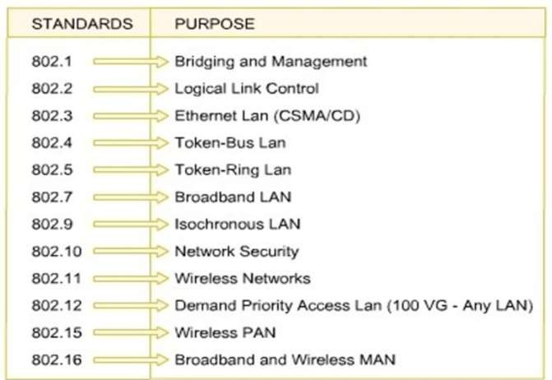
1.3 ETHERNET
IEEE 802 Standards
A committee of the Institute of Electrical and Electronics Engineers (IEEE) responsible for developing
802.3 group
is responsible for issuing LANs that are
standards for
referred to
commercially as Ethernet.
Currently, Ethernet systems are available at
speeds up to 100 Gbps. Here’s a brief chronology.
1983: 10 Mbps (megabit per second, million bits per second)
1995: 100 Mbps
1998: 1 Gbps (gigabits per second, billion bits per second)
2003: 10 Gbps
2010: 40 Gbps and 100 Gbps
Coming soon (as of this writing) are standards at 2.5, 5, 25, 50, and 400 Gbps

Slide 30
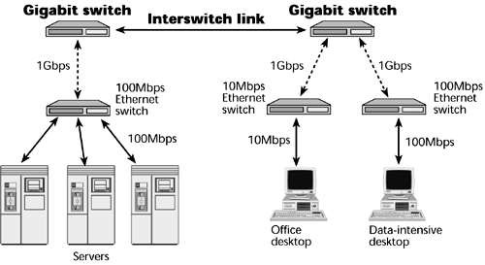
1.3 ETHERNET
1-Gbps Ethernet
For a number of years, the initial standard of Ethernet, at 10 Mbps, was adequate for most office environments.
By the early 1990s, higher data rates were needed to support the growing traffic load on the typical LAN.
In many multimedia applications, there is a need for client system to be able to draw huge amounts of data from multiple, centralized servers, called server farms.
As the performance of the servers has increased, the network becomes the bottleneck.
Power workgroups consist of a small number of cooperating users who need to exchange massive data files across the network such as software development and computer-aided design.
local backbone: As processing demand grows, enterprises develop an architecture of multiple LANs interconnected with a high-speed backbone network.

Slide 31
1.3 ETHERNET
10-Gbps Ethernet
Even as the ink was drying on the 1-Gbps specification, the continuing increase in local traffic made this specification inadequate for needs in the short-term future.
Accordingly, the IEEE 802.3 committee soon issued a standard for 10-Gbps Ethernet. The principle driving requirement for 10- Gbps Ethernet was the increase in intranet (local interconnected networks) and Internet traffic. A number of factors contribute to the explosive growth in both Internet and intranet traffic:
An increase in the number of network connections
An increase in the connection speed of each end-station (for example, 10-Mbps users moving to 100 Mbps, analog 56k users moving to DSL and cable modems)
An increase in the deployment of bandwidth-intensive applications such as high- quality video.
An increase in web hosting and application hosting traffic
Initially, network managers used 10-Gbps Ethernet to provide high-speed, local backbone interconnection between large-capacity switches.

Slide 32
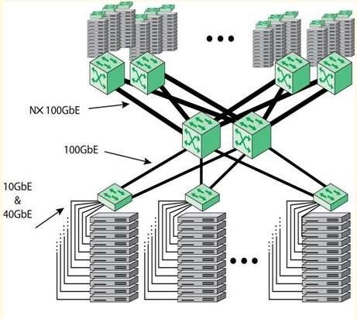
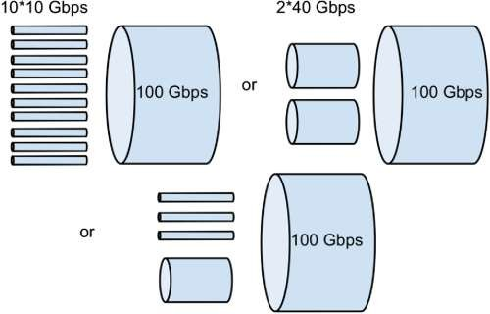
1.3 ETHERNET
100-Gbps Ethernet
The authorization request justified the need for two different data rates in the new standard (40 Gbps and 100 Gbps) by recognizing that aggregate network requirements and end- station requirements are increasing at different rates.
The following are market drivers for 100-Gbps Ethernet:
Data center/Internet media providers: To support the growth of Internet multimedia content and web applications, content providers have been expanding data centers, pushing 10-Gbps Ethernet to its limits.
Metro video/service providers: Video on demand has been driving a new generation of 10-Gbps
Ethernet metropolitan/core network buildouts.
Enterprise LANs: Continuing growth in convergence of voice/video/data and in unified communications is driving up network switch demands.
Internet exchanges/ISP core routing: With the massive amount of traffic flowing through these nodes,
The trend at large data centers, with
The switches are often mounted in the rack and referred to as top-of-rack (ToR) switches.

Slide 33
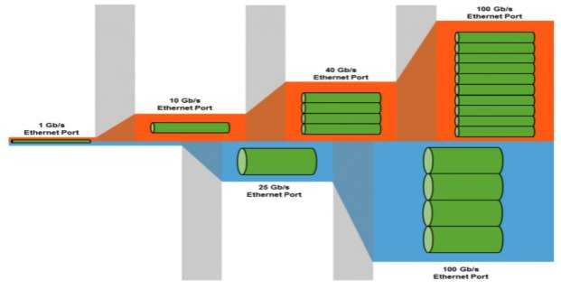
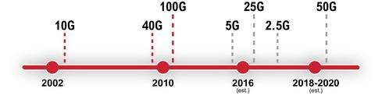
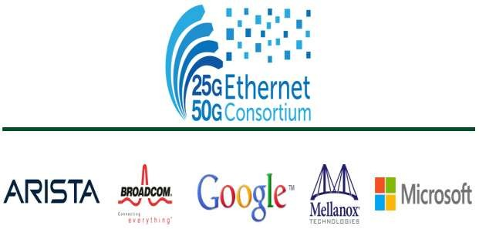
1.3 ETHERNET
25-Gbps 802.3cc
50-Gbps 802.3cd
One of the options for implementing 100-Gbps is as four 25-Gbps physical lanes.
Such considerations have led to the form of the 25 Gigabit Ethernet Consortium by a number of leading cloud networking providers, including Google and Microsoft.
The objective of the Consortium is to support an industry-standard, interoperable Ethernet specification that boosts the performance and slashes the interconnect cost per Gbps between the NIC and ToR switch.
The specification adopted by the Consortium prescribes a single-lane 25-Gbps Ethernet and dual-lane 50-Gbps Ethernet link protocol, enabling up to 2.5 times higher performance per physical lane on twinax copper wire between the rack endpoint and switch compared to 10-Gbps and 40- Gbps Ethernet links.

Slide 34
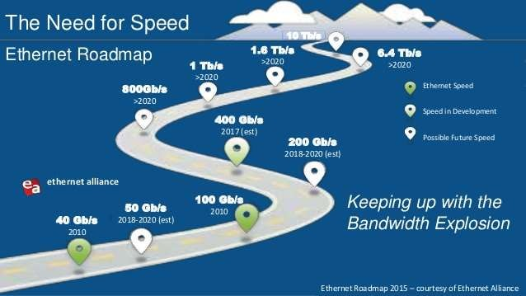
1.3 ETHERNET
Terabit Ethernet IEEE 802.3bs
The growth in demand never lets up.
Terabit Ethernet or TbE is used to describe speeds of Ethernet above 100 Gbit/s. 400 Gigabit Ethernet (400G, 400GbE) and 200 Gigabit Ethernet (200G, 200GbE)
standards developed by the IEEE P802.3bs Task Force using broadly similar technology to 100 Gigabit Ethernet were approved on December 6, 2017
IEEE 802.3 is currently exploring technology options for producing a 400- Gbps Ethernet standard, although no timetable is yet in place.
Looking beyond that milestone, there is widespread acknowledgment that a 1- Tbps (terabits per second, trillion bits per second) standard will eventually be produced.

Slide 35
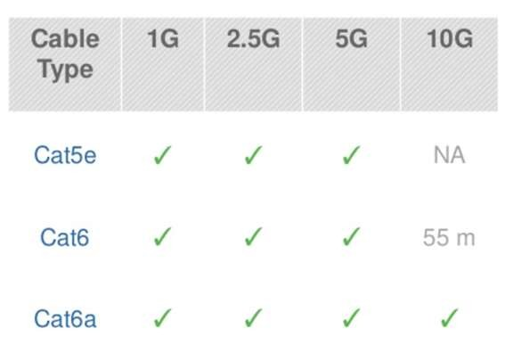
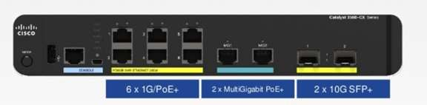
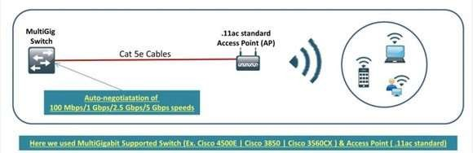
1.3 ETHERNET
2.5/5-Gbps Ethernet IEEE 802.3bz
These relatively low speeds are also known as
Multirate Gigabit BASE-T (MGBASE-T).
Currently, the MGBASE-T Alliance is overseeing the development of these standards outside of IEEE.
It is likely that the IEEE 802.3 committee will ultimately issue standards based on these industry efforts.
These new data rates are mainly intended to support IEEE 802.11ac wireless traffic into a wired network.
IEEE 802.11ac is a 3.2-Gbps Wi-Fi standard that is gaining acceptance where more than 1 Gbps of throughput is needed, such as to support mobile users in the office environment.
This new wireless standard overruns 1- Gbps Ethernet link support but may not require the next step up, which is 10 Gbps.
Assuming that 2.5 and 5 Gbps can be made to work over the same cable that supports 1 Gbps, this would provide a much needed uplink speed

Slide 36
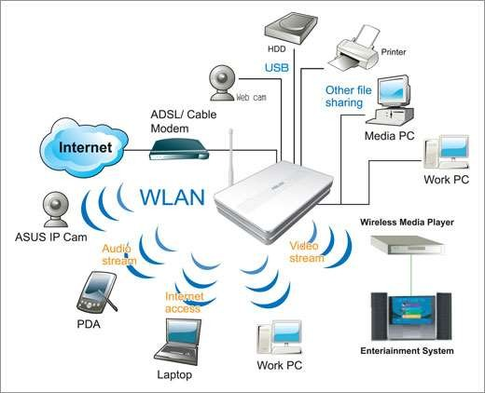
1.4 WI-FI
Just as Ethernet has become the dominant technology for wired LANs, so WiFi, standardized by the IEEE 802.11 committee, has become the dominant technology for wireless LANs.
Refers to the wireless LAN technology standardized by the IEEE 802.11 committee.
The term WiFi designates products that have been
certified by the Wi-Fi Alliance to conform to the
802.11 standards and have passed interoperability tests.
Applications of Wi-Fi
Wi-Fi is the predominant wireless Internet access technology, used in homes, offices, and public spaces.
Wi-Fi in the home now connects computers, tablets, smartphones, and a host of electronic devices, such as video cameras, TVs, and thermostats.
Wi-Fi in the enterprise has become an essential means of enhancing worker productivity and network effectiveness.

Slide 37
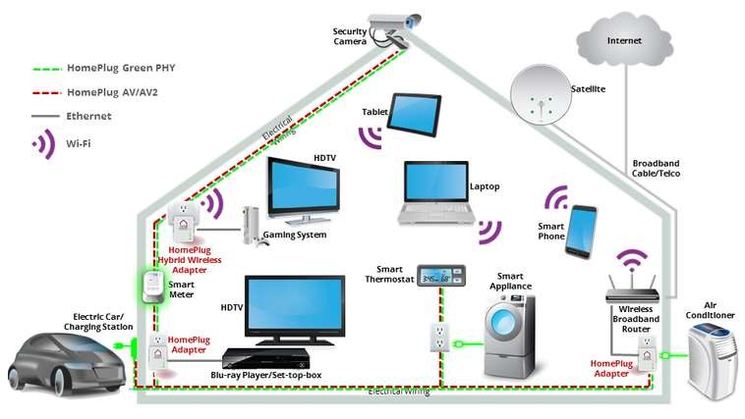
Wi-Fi in the Home
The first important use of Wi-Fi in the home was to replace Ethernet cabling for connecting desktop and laptop computers with each other and with the Internet.
A typical layout is a desktop computer with an attached router/modem that provides an interface to the Internet.
Wi-Fi greatly simplified the hookup.
Not only is there no need for a physical cable hookup, but the laptops can be moved easily from room to room or even outside the house.
Because both Wi-Fi and cellular capability are now standard on both smartphones and tablets, the home Wi-Fi provides a cost- effective way to the Internet.
The smartphone or tablet will automatically use a Wi-Fi connection to the Internet if available, and only switch to the more expensive cellular connection if the Wi-Fi is unavailable.

Slide 38
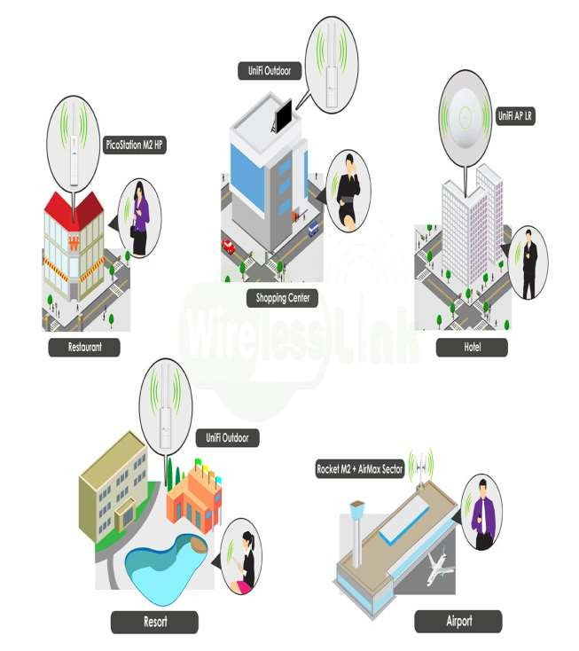
1.4 WI-FI Public Wi-Fi
Access to the Internet via Wi-Fi has expanded dramatically in recent years, as more and more facilities provide
a Wi-Fi hotspot, which enables any Wi-Fi device to attach.
Wi-Fi hotspots are provided in coffee shops, restaurants, train stations, airports, libraries, hotels, hospitals, department stores, RV parks, and many other places.
So many hotspots are available that it is rare to be too far from one.
There are smartphone
now numerous tablet apps that increase
and their
convenience.
Even very remote places will be able to support hotspots with the development of the satellite Wi-Fi hotspot.
The first company to develop such a product is
the satellite communications company Iridium.
The satellite modem will initially provide a

Slide 39
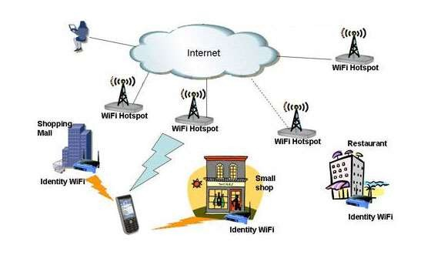
1.4 WI-FI Enterprise Wi-Fi
Wi-Fi connections to the enterprise network have been offered by many organizations of all sizes, including public and private sector.
Two trends have driven the transition to a Wi-Fi- centered enterprise.
First, the demand has increased, with more and more employees preferring to use laptops, tablets, and smartphones to connect to the enterprise network, rather than a desktop computer.
Second, the arrival of Gigabit Ethernet, especially the IEEE 802.ac standard, allows the enterprise network to support high-speed connections to many mobile devices simultaneously.
Enterprises accepted the need for, and then began to encourage, the practice known as bring your own device (BYOD).
Employees can use the same devices and the same applications to continue their work or check their e-mail from wherever they are—home, at their local coffee shop, or while traveling.

Slide 40
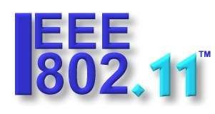

1.4 WI-FI Standards
Essential to the success of Wi-Fi is interoperability.
Wi-Fi-enabled devices must be able to
communicate with Wi-Fi access points, such as the home router, the enterprise access point, and public hotspots, regardless of the manufacturer of
the device or access point.
Such interoperability is
organizations.
guaranteed by two
First, the IEEE 802.11 wireless LAN committee develops the protocol and signaling standards for Wi-Fi.
Second the Wi-Fi Alliance creates test suites to certify interoperability for commercial products that conform to various IEEE 802.11 standards.
The term WiFi (wireless fidelity) is used for products certified by the Alliance.
IEEE 802.11 Wireless LAN Working Group

Slide 41
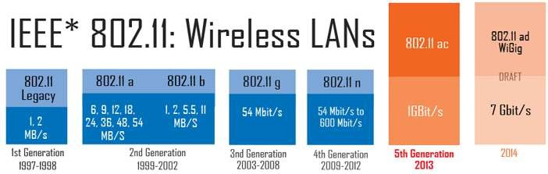
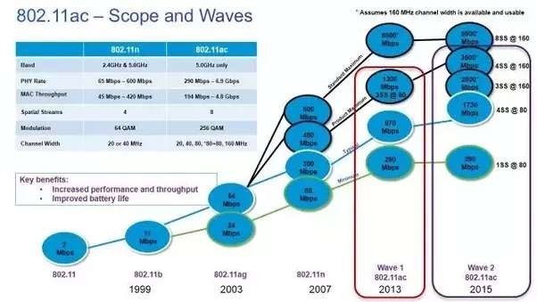
Wi-Fi Data Rates
Just as businesses and home users have generated a need to extend the Ethernet standard to speeds in the gigabits per second (Gbps) range, the same requirement exists for Wi-Fi.
As the technology of antennas, wireless transmission techniques, and wireless protocol design has evolved, the IEEE 802.11 committee has been able to introduce standards for new versions of Wi-Fi at ever-higher speeds.
Once the
standard is issued, industry quickly
develops the products.
Here’s a brief chronology, starting with the original standard, which was simply called IEEE 802.11, and showing the maximum data rate for each version :
802.11 (1997): 2 Mbps (megabits per second, million bits per second)
802.11a (1999): 54 Mbps
802.11b (1999): 11 Mbps
802.11n (1999): 600 Mbps
802.11g (2003): 54 Mbps

Slide 42
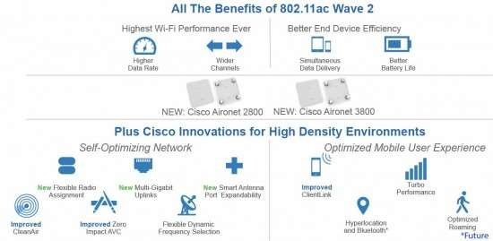
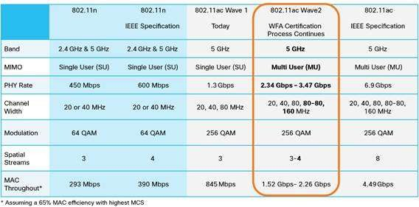
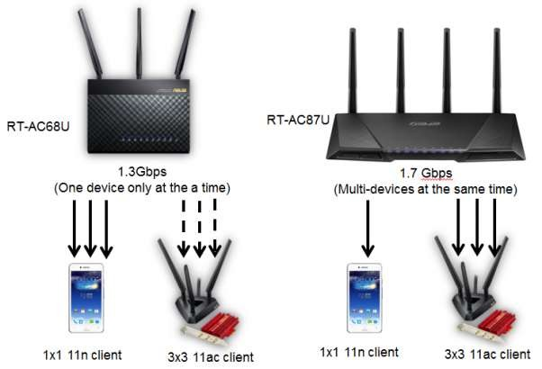
Wi-Fi Data Rates IEEE 802.11ac
operates in the 5-GHz band, as does the older and slower standards 802.11a and 802.11n.
It is designed to provide a smooth evolution from 802.11n.
This new standard makes use of advanced technologies in antenna design and signal processing to achieve much greater data rates, at lower battery consumption, all within the same frequency band as the older versions of Wi-Fi.
IEEE 802.11ac is likely to be the preferred gigabit Wi- Fi option for this environment.

Slide 43
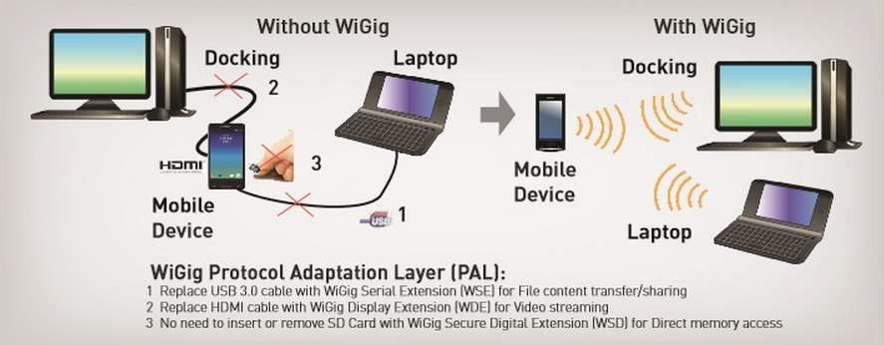
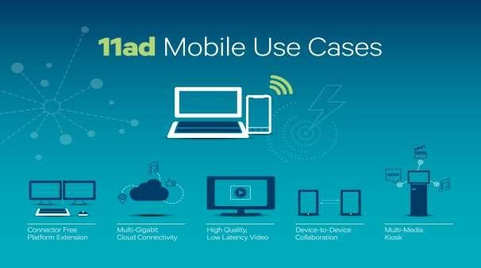
Wi-Fi Data Rates IEEE 802.11ad
a version of 802.11 operating in the 60-GHz frequency band.
This band offers the potential for much wider channel bandwidth than the 5-GHz band, enabling high data rates with relatively simple signal encoding and antenna characteristics.
Few devices operate in the 60-GHz band, which means communication experiences less interference than in the other bands used for Wi-Fi.
Because of the inherent transmission limitations of the 60-GHz band, 802.11ad is likely to be useful only within a single room
Because it can support high data rates and, for example, could easily transmit uncompressed high-definition video, it is suitable for applications such as replacing wires in a home entertainment system, or streaming high-definition movies from your cell phone to your television.
In the office environment, the demand for ever

Slide 44

1.5 4G/5G CELLULAR
Cellular technology is the foundation of mobile wireless communications and supports users in locations that are not
easily served by wired
the
networks.
•
Cellular technology is
underlying technology for mobile telephones, personal communications systems, wireless Internet and wireless web applications, and much more.
This section looks at how cellular technology has evolved through four generations and is poised for a fifth generation.

Slide 45

1.5 4G/5G CELLULAR
First Generation
The original cellular networks, now dubbed 1G, provided analog traffic channels and were designed to be an extension of the public switched telephone networks.
Users with brick-sized cell phones placed and received calls in the same fashion as landline subscribers.
The most widely deployed 1G system was the Advanced Mobile Phone Service (AMPS), developed by AT&T.
Voice transmission was purely analog and control signals were sent over a 10-kbps analog channel.
1G systems send user traffic in the clear, providing no security.
In 1G systems, each cell supports a number of channels. At any given time a channel is allocated to only one user.

Slide 46

1.5 4G/5G CELLULAR
Second Generation
First-generation cellular networks quickly became highly popular, threatening to swamp available capacity.
Second-generation (2G) systems were developed to provide higher-quality signals, higher data rates for support of digital services, and greater capacity.
Key differences between 1G and 2G networks include the following:
Digital traffic channels: 1G systems are designed to support voice channels; digital traffic is supported only by the use of a modem that converts the digital data into
analogform. 2G systems provide digital traffic channels.
Encryption: Because all the user traffic, and the control traffic, is digitized in 2G systems, it is a relatively simple matter to encrypt all the traffic to prevent eavesdropping.
All 2G systems provide this capability,
Error detection and correction: The digital traffic stream of 2G systems also lends itself to the use of error detection and correction techniques.
Channel access: as 1G the 2G systems also provide multiple channels per cell, but On the contrary 1G each.

Slide 47

1.5 4G/5G CELLULAR Third Generation
The objective of the third generation (3G) of wireless communication is to provide fairly high-speed wireless
communications to support multimedia, data, and video in addition to voice. 3G systems has the following features:
Bandwidth: 3G systems has channel usage to
5 MHz .
Data rate: Target data rates are 144 and 384 kbps.
Multirate: The term multirate refers to the provision of multiple fixed-data-rate logical channels to a given user, in which different data rates are provided on different logical
channels. Further, the traffic on each logical channel can be switched independently through the wireless and fixed networks to different destinations.

Slide 48

1.5 4G/5G CELLULAR
Fourth Generation
The evolution of smartphones and cellular networks has ushered in a new generation of capabilities and standards, which is collectively called 4G.
4G systems provide ultra-broadband Internet access for a variety of mobile devices including laptops, smartphones, and tablets.
4G networks support Mobile web access and high-bandwidth applications such as high- definition mobile TV, mobile video conferencing, and gaming services.
4G systems have the following characteristics:
Based on an all-IP packet switched network
Support peak data rates of up to approximately 100 Mbps for high-mobility mobile access and up to approximately 1 Gbps for low-mobility access such as local wireless access
Dynamically share and use the network resources to support more simultaneous users per cell

Slide 49

1.5 4G/5G CELLULAR
Fifth Generation
5G systems are still some years away (perhaps 2020), but 5G technologies are likely an area of active research.
By 2020, the huge amounts of data traffic generated by tablets and smartphones will be augmented by an equally huge, and perhaps much larger, amount of traffic from the Internet of Things, which includes shoes, watches, appliances, cars, thermostats, door locks, and much more.
With 4G, we may have reached a point of diminishing returns on network efficiency.
There will be incremental improvements in the future, but significant increases in transmission efficiency seem unlikely.
Instead, the focus for 5G will be on building more intelligence into the network, to meet service quality demands by dynamic use of priorities, adaptive network reconfiguration, and other network management techniques.

Slide 50

1.6 CLOUD COMPUTING
This section provides a brief overview of cloud
computing, which is dealt with in greater detail
later in the book.
Although the general concepts for computing go back to the 1950s,
cloud
cloud
computing services first became available in the early 2000s, particularly targeted at large enterprises.
Since then, cloud computing has spread to small- and medium-size businesses, and most recently to consumers.
Apple’s iCloud was launched in 2012 and had 20 million users within a week of launch. Evernote, the cloud-based note-taking and archiving service, launched in 2008, approached 100 million users in less than six years.
In late 2014, Google announced that Google Drive
had almost a quarter of a billion active users.
Here, we look at the key elements of clouds, including cloud computing, cloud networking, and cloud storage.

Slide 51

1.6 CLOUD COMPUTING
characteristics of cloud computing :
The National Institute of Standards and Technology
(NIST) defines the essential characteristics of cloud computing as follows:
Broad network access: Capabilities are available over
the network and accessed through standard mechanisms that promote use by heterogeneous thin or thick client platforms (for example, mobile phones, laptops, and personal digital assistants [PDAs]) and other traditional or cloud-based software services.
Rapid elasticity: Cloud computing enables you to
expand and reduce resources according to your specific service requirement. For example, you may need a large number of server resources for the
duration of a specific task. You can then release these resources upon completion of the task.
Measured service: Cloud systems automatically
control and optimize resource use by leveraging a metering capability at some level of abstraction appropriate to the type of service.

Slide 52

1.6 CLOUD COMPUTING
characteristics of cloud computing :
Ondemand self-service:
A consumer can unilaterally provision computing capabilities, such as server time and network storage, as needed automatically without requiring human interaction with each service provider. Because the service is on demand, the resources are not permanent parts of your IT infrastructure.
Resource pooling: The provider’s computing resources are pooled to serve multiple consumers using a multitenant model, with different physical and virtual resources dynamically assigned and reassigned according to consumer demand. There is a degree of location independence in that the customer generally has no control or knowledge over the exact location of the provided resources, but may be able to specify location at a higher level of abstraction (for example, country, state, or data center). Examples of resources include storage, processing, memory, network bandwidth, and virtual machines. Even private clouds tend to pool resources between different parts of the same organization.

Slide 53

1.6 CLOUD COMPUTING
The Benefits of Cloud Computing
Cloud computing provides economies of scale, professional network management, and professional security
management.
These features can be attractive to companies large and small, government agencies, and individual PC and mobile users.
The individual or company needs to pay only for the storage capacity and services they need. The user, be it company or individual, does not have the hassle of setting up a database system, acquiring the hardware they need, doing maintenance, and backup up the data; all this is part of the cloud service.
In theory, another big advantage of using cloud computing to store your data and share it with others is that the cloud provider takes care of security.
Alas, the customer is not always protected, there have been a number of security failures.

Slide 54

1.6 CLOUD COMPUTING
Cloud Networking
Cloud networking refers to the networks and network management functionality that must be in place to enable cloud computing.
Many cloud computing solutions rely on the Internet, but that is only a piece of the networking infrastructure.
One example of cloud networking is the provisioning high-performance/high-reliability networking between the provider and subscriber.
In this case, some or all of the traffic between an enterprise and the cloud bypasses the Internet and uses dedicated private network facilities owned or leased by the cloud service provider.
More generally, cloud networking refers to the collection of network capabilities required to access a cloud, including making use of specialized services over the Internet, linking enterprise data centers to a cloud.

Slide 55

1.6 CLOUD COMPUTING
The Benefits of Cloud Computing
Cloud Storage
We can think of cloud storage as a subset of cloud computing.
In essence, cloud storage consists of database storage and database applications hosted remotely on cloud servers.
Cloud storage enables small businesses and individual users to take advantage of data storage that scales with their needs and to take advantage of a variety of database applications without having to buy, maintain, and manage the storage assets.

Slide 56

1.7 INTERNET OF THINGS
The Internet of Things (IoT) is the latest development in the long and continuing revolution of
computing and communications.
Its size, ubiquity, and influence on everyday lives, business, and government dwarf any technical advance that has gone before.
This section provides a brief overview of the IoT, which is dealt with in greater detail later in the Slides.
So Internet of Things (IoT) is the expanding connectivity, particularly via the Internet of a wide range of sensors, actuators, and other embedded systems.
In almost all cases, there is no human user, with interaction fully automated.

Slide 57

1.7 INTERNET OF THINGS
Things on the Internet of Things
The Internet of Things (IoT) is a term that refers to the expanding interconnection of smart devices, ranging from appliances to tiny sensors.
A dominant theme is the embedding of short-range mobile transceivers into a wide array of gadgets and everyday items, enabling new forms of communication between people and things, and between things themselves.
The Internet now supports the interconnection of billions of industrial and personal objects, usually through cloud systems.
The objects deliver sensor information, act on their environment, and in some cases modify themselves, to create overall
management of a larger system, like a factory or city.

Slide 58

1.7 INTERNET OF THINGS
Evolution
the Internet has gone through roughly four generations of deployment culminating in the IoT:
Information technology (IT): PCs, servers, routers,
firewalls, and so on, bought as IT devices by enterprise IT people, primarily using wired connectivity.
Operational technology (OT): Machines/appliances with embedded IT built by non-IT companies, such as medical machinery, SCADA (supervisory control and
data acquisition), process control, and kiosks bought as appliances by enterprise OT people and primarily using wired connectivity.
Personal technology: Smartphones, tablets, and
ebook readers bought as IT devices by consumers (employees) exclusively using wireless connectivity and often multiple forms of wireless connectivity.
Sensor/actuator technology: Single-purpose
devices bought by consumers, IT, and OT people exclusively using wireless connectivity, generally of a single form, as part of larger systems.

Slide 59

1.7 INTERNET OF THINGS
Layers of the Internet of Things
Some resources define it as 5 or 6 or 7 layer , at all you will find these layers
Sensors and actuators: These are the things. Sensors observe their environment and report back quantitative measurements of such variables as temperature, humidity, presence or absence of some observable,. Actuators operate on their environment, such as changing a thermostat setting or operating a valve.
Connectivity: wireless or wired link into a network to send collected data to the appropriate data center (sensor) or receive operational commands from a controller site (actuator).
Capacity: The network supporting the devices must be able to handle a potentially huge flow of data.
Storage: There needs to be a large storage facility to store and maintain backups of all the collected data.

Slide 60

1.8 NETWORK CONVERGENCE
It is The provision of telephone, video, and
data
communication services within a single network.
the major attributes of the three-layer model of enterprise communications.
convergence involves
moving an organization’s voice,
video, and image traffic to a single network infrastructure.
This often involves integrating distinct voice and data networks into a single network infrastructure and extending the infrastructure to support mobile users.
The foundation of this convergence is packet-based transmission using the Internet Protocol (IP).
Using IP packets to deliver all varieties of communications traffic, sometimes referred to as everything over IP, enables the underlying infrastructure to deliver a wide range of useful applications to business users.
Convergence brings many benefits, including simplified network management, increased efficiency, and greater flexibility at the application level.
a converged network infrastructure provides a predictable platform on which to build new add applications that combine video, data, and voice.

Slide 61

1.8 NETWORK CONVERGENCE
You can think of this convergence in terms of a three-layer model of enterprise communications:
Application convergence:
These are seen by the end users of a business.
Convergence integrates communications applications, such as voice calling (telephone), voice mail, e-mail, and
instant messaging, with
business applications, such as workgroup
collaboration, customer relationship
management, and backoffice functions.
With convergence, applications provide rich features that incorporate voice,
data, and video in a seamless, organized, and value-added manner.
One example is multimedia messaging,
which enables a user to use a single interface to access messages from a variety of sources.

Slide 62

1.8 NETWORK CONVERGENCE
It is The provision of telephone, video, and data communication services within a single network.
You can think of this convergence in terms of a three-layer model of enterprise communications:
Enterprise services:
At this level, the manager deals with the information network in terms of the services that must be available to ensure that users can take full advantage of the applications that they use.
For example, network managers need to make sure that appropriate privacy mechanisms and authentication services are in place to support convergence- based applications.
They may also be able to track user locations to support remote print services and network storage facilities for mobile workers.

Slide 63

1.8 NETWORK CONVERGENCE
Infrastructure:
The network and communications infrastructure consists of the communication links, LANs, WANs, and Internet connections available to the enterprise. Increasingly, enterprise network
infrastructure also includes private/public cloud connections to data centers that host high-volume data
storage and web services.
A key aspect of convergence at this level is the
ability to carry voice, image, and
video over networks that were originally designed to carry data traffic. Infrastructure convergence has also
occurred for networks that were designed for voice traffic. For example, video, image, text, and data are
routinely delivered to smartphone users over cell phone networks.

Slide 64

1.8 NETWORK CONVERGENCE
The following list summarizes three key benefits of IP
network convergence:
Cost savings: provide significant double-digit percent reductions in network administration, maintenance, and operating costs; converging legacy networks onto a single IP network enables better use of existing resources, and implementation of centralized capacity planning, asset management, and policy management.
Effectiveness: The converged environment has the potential to provide users with great flexibility, irrespective of where they are. IP convergence allows companies to create a more mobile workforce. Mobile workers can use a virtual private network (VPN) to remotely access business applications and communication services on the corporate network.
Transformation: enables the enterprise-wide adoption of global standards and best practices, thus providing better data, enhanced real-time decision making, and improved execution of key business processes and operations.

Slide 65

1.9 UNIFIED COMMUNICATIONS
A concept related to network convergence is
unified communications (UC).
It is The integration of real-time enterprise communication services such as instant messaging, presence information, voice (including IP telephony), web and video conferencing, and speech recognition with nonreal- time communication services such as unified messaging (integrated voice mail, e-mail, SMS, and fax).
Whereas enterprise network convergence focuses on the consolidation of traditionally distinct voice, video, and data communications networks into a common infrastructure, UC focuses on the integration of real-time communication services to optimize business processes.

Slide 66

1.9 UNIFIED COMMUNICATIONS Key elements of UC include the following:
UC systems typically provide a unified user interface and
consistent user
experience
device and
across multiple
media.
UC merges
real-time
communications services with non-real-time services and business process applications.

Slide 67

1.9 UNIFIED COMMUNICATIONS
The key elements of this architecture are as
follows:
Realtime communications (RTC) dashboard:
An RTC dashboard is a key component of UC architecture.
This is the element that provides UC users with
a unified user interface across communication devices.
Ideally, the user has a consistent interface no matter what communication device the user is
currently using, whether it is a cell phone,
desktop system, or office telephone attached
to the corporate private branch exchange (PBX).
dashboards provide access to realtime communication services such as instant messaging, audio and video conferencing, and interactive whiteboards; RTC dashboards also provide access to non-real-time services such as unified messaging (e-mail, voice mail, fax, and SMS) in unified view.

Slide 68



1.9 UNIFIED COMMUNICATIONS
The key elements of this architecture are as
follows:
Web conferencing:
Refers to live meetings or presentations in which participants access the meeting or presentation via a mobile device or the
web, either over the Internet, or corporate intranet.
Web conferences often include data sharing through web-connected interactive white boards (IWBs).

Slide 69


1.9 UNIFIED COMMUNICATIONS
The key elements of this architecture are as
follows:
Audio conferencing:
Also called conference calling, refers to a live meeting in which participants are linked together for audio transmission and reception.
A participant may be on a landline, mobile phone, or at a “softphone”—a computer equipped with microphone and speaker.

Slide 70

1.9 UNIFIED COMMUNICATIONS
The key elements of this architecture are as
follows:
Unified messaging:
Unified messaging systems provide a common repository for messages from multiple sources.
It allows users to retrieve saved e-mail, voice mail, and fax messages from a computer, telephone, or mobile device
Computer users can select and play voice-mail recordings that appear in their unified messaging inboxes.
Telephone users can both retrieve voice mail and hear text-to-voice translations of e-mail messages.
Messages of any type can be saved, answered, filed, sorted, and forwarded. Unified messaging systems relieve business users from having to monitor multiple voice mailboxes by enabling voicemail messages received by both office phones and cell phones to be saved to the same mailbox.

Slide 71

1.9 UNIFIED COMMUNICATIONS
The key elements of this architecture are as
follows:
Instant messaging (IM):
Real-time text-based messaging between two or more participants.
IM is similar to online chat because it is text-based and exchanged bidirectionally in real time.
IM is distinct from chat in that IM clients use contact (or buddy) lists to facilitate connections between known users, whereas online chat can include text- based exchanges between anonymous users.

Slide 72

1.9 UNIFIED COMMUNICATIONS
The key elements of this architecture are as
follows:
Video teleconferencing (VTC):
Videoconferencing allows users in two or more locations to interact simultaneously via two-way video and audio transmission
UC systems enable users to participate in video conferences via desktop computers, smartphones, and mobile devices.

Slide 73

1.9 UNIFIED COMMUNICATIONS
The key elements of this architecture are as follows:
Presence:
The capability to determine, in real time, where someone is, how that person prefers to be reached, and even what the person is currently doing.
Presence information shows the individual’s availability state before co-workers attempt to contact them
person.
It was once technology to
considered simply an underlying instant messaging (for example,
“available to chat” or “busy”) but has been broadened to include whether co-workers are currently on office or mobile phones, logged in to a computer, involved in a video call or in a meeting, or out of the office for lunch or vacation.
A co-worker’s geographic location is becoming more common as an element in presence information for a number of business reasons, including the capability to quickly respond to customer emergencies.

Slide 74

Foundations of Modern Networking PART I Modern Network
Chapter 1: Elements of Modern Networking
1.9 UNIFIED COMMUNICATIONS
The key elements of this architecture are as
follows:
IP enabling contact centers:
Refers to the use of IP-based unified communications to enhance customer contact center functionality and performance.
The unified communications infrastructure makes use of presence technology to enable customers and internal enterprise employees to be quickly connected to the required expert or support person.
In addition, this technology supports mobility, so that call center personnel need not be located at a particular office or remain in a particular place.
Finally, the UC infrastructure enables the call center employee to quickly access other employees and information assets, including data, video, image, and audio.

Slide 75

Foundations of Modern Networking PART I Modern Network
Chapter 1: Elements of Modern Networking
1.9 UNIFIED COMMUNICATIONS
The key elements of this architecture are as
follows:
IP/mobility:
Refers to the delivery of information to and collection of information from enterprise personnel who are usually mobile, using an IP network infrastructure.
In a typical enterprise, upward of 30 percent of employees use some form of weekly remote access technology in the performance of their jobs.

Slide 76

Foundations of Modern Networking PART I Modern Network
Chapter 1: Elements of Modern Networking
1.9 UNIFIED COMMUNICATIONS
The key elements of this architecture are as follows:
Converged IP/wireless infrastructure:
A unified networking and communications-based IP packet transfer to support voice, data, and video transmission and can be extended to include local- and wide-area wireless communications.
UC-enabled mobile devices are able to switch between Wi-Fi and cellular systems in the middle of a communication session.
For example, a UC user could receive a co-worker’s call via a smartphone connected to Wi-Fi network at home, continue the conversation while driving to work over a cellular network connection, and could end the call at the office while connected to the business’s Wi-Fi network.
Both handoffs (home Wi-Fi to cellular and cellular to office Wi-Fi) would take place seamlessly and transparently without dropping the call.

Slide 77

1.9 UNIFIED COMMUNICATIONS
The importance of UC is not only that it integrates communication channels but also that it offers a way to integrate communication functions and business applications. Three major categories of benefits are typically realized by organizations that use UC:
Personal productivity gains:
Presence information helps employees find each other and choose the most effective way to communicate in real time.
Less time is wasted calling multiple numbers to locate co-workers or checking multiple worked-related voice mailboxes.
Calls from VIP contacts can be routed simultaneously to all of a UC user’s phone devices (office phone, softphone, smartphone, home phone) to ensure faster responsiveness to customers, partners, and co-workers.

Slide 78

1.9 UNIFIED COMMUNICATIONS
The importance of UC is not only that it integrates communication channels but also that it offers a way to integrate communication functions and business applications. Three major categories of benefits are typically realized by organizations that use UC:
Workgroup performance gains:
UC systems support real-time collaboration among team members, which facilitates workgroup performance improvements.
Examples include the use of presence information to speed identification of an available individual with the right skills a work team needs to address a problem.
Enhanced conferencing capabilities with desktop VTC and interactive white boards and automated business rules to route or escalate communications also help to increase workgroup performance.

Slide 79

1.9 UNIFIED COMMUNICATIONS
The importance of UC is not only that it integrates communication channels but also that it offers a way to integrate communication functions and business applications. Three major categories of benefits are typically realized by organizations that use UC:
Enterprise level process improvements:
IP convergence enables UC to be integrated with enterprisewide and departmental-level applications, business processes, and workflows.
UC-enabled enhanced communications with customers, suppliers, and business partners are redefining best practices for customer relationship management (CRM), supply chain management (SCM), and other enterprise-wide applications and are transforming relationships among members of business networks.

